Slide 1
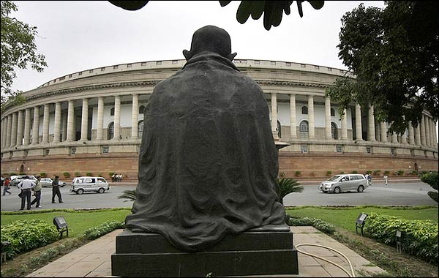
GALGOTIAS YOUTH
PARLIAMENT
2012

Slide 2
What is YP?
Mock Lok Sabha
Based on the principles of the House
Involves intense debates and discussion
Revolves around the set agenda

Slide 3
Seating
Ruling party to sit on the right side of the chair
Opposition and other alliances to sit on the left side of the chair
Both sides more or less equal in no.

Slide 4
Decorum
No cross-talks
Communication through chits
Debating in a civilized sense
Only moderate banging of tables allowed
Expulsion in case of fight/inappropriate behavior

Slide 5
Language
English/Hindi
Only 1 particular use of language while debating, no ‘Hinglish’

Slide 6
Procedure
1. National Anthem
2. Oath of Speaker
3. Question Hour (15-20 min)
4. Setting list of business (agenda – by speaker)
5. Taking motions
6. Discussion
7. Half Hour Discussion (unmoderated caucus)
8. Introduction of Bills
9. Reading of Bills (discussion and amendments)
10. Voting (simple majority)

Slide 7
Question Hour
The question has been defined as an instrument by which a member can elicit information on any matter of public importance.
• STARRED QUESTIONS: Meant for oral answers
• UNSTARRED QUESTIONS: Meant for written answers
• Can ask questions (not more than 2) to any particular minister
• PM is not answerable; he may speak on his wish.

Slide 8
List of Business
Agenda of the conference
Set by the Speaker

Slide 9
Provisional Speakers List
Speech of the MP on the agenda
MPs may put their names on the list by sending chits to the Speaker

Slide 10
Raising Motions
By sending written motion to the Speaker when asked
Only 1 motion at a time
Choice of Speaker – voted by members
MP raising that motion is the default speaker
Others can add their names to provisional speakers list by sending chit to dais

Slide 11
Privileges to MPs
POINT OF INQUIRY:
Enquiry about parliamentary procedures and conduct to the chair.
POINT OF ORDER:
This maybe introduced in order to complain about improper parliamentary procedures, however the Chair may overrule the point
This can also be used in case of a factual error

Slide 12
RIGHT TO REPLY:
If a particular member present feels that a grave (or false) statement has made by others towards that member, he/she may privilege the right of reply with the permission of the chair.
Point of Personal Privilege
This may be used in order to remove a personal discomfort

Slide 13
Half-Hour Discussion
An informal session for members to discuss and deliberate on the topic
No intervention of the Chair
Duration may vary
Respect the decorum

Slide 14
Introducing Bill
Single bill to be introduced by a MP
Only 1 bill to be introduced at a time

Slide 15
Reading of Bill
Discussion
Amendments
Addition
Deletion
Edition

Slide 16
Voting
Simple majority required
No abstentions

Slide 17
Important Points
Attire - Indian/Western formals
Laptops allowed
No internet usage (except for Half Hour discussion)
Do research thoroughly

